Slide 1

Intro to Version Control
16 Jan 2017
Dr. Greg Erhardt
261 OHR 859-699-1761 greg.erhardt@uky.edu

Slide 2
Questions
1. The import math line in the beginning of the notebook and where that comes from/what can be imported
2. What pandas and numpy do, where they come from
3. np.random.randn and np.log: what np does/represents
1.) The Pylab Interactive Plotting Environment
2.) Python Scripts
3.) A little rough on the variable names and types
My first question is why did we have to import the pandas as pd when we did not use it? Does it serve another purpose?
Next two questions are on the help commands. I could not figure out exactly how to use the tab command to see the options thing. Could you provide an example with that?
The other question is about adding the question mark. Does the question mark work for every function, or are is it just on some functions?

Slide 3
Questions
1) I don't have any experience using markdown so all of that is new to me
2) I have not used one of these notebooks before it was a little unclear how to run multiple blocks of code that are separate
3) I also have never used the libplot python stuff
-The notebook does not allow me to extract the files to open the Introduction-to-juypter-notebooks-and-python
-There are many problems when looking at strings and how they relate names of places or things to the coding language within python.
-Print and Type work as green messages, however strings do not give us the correct information regarding the computer programming language.
Why we needed to import math before calculating sqrt or displaying pi?
What are pandas, numpy and matplotlib.pyplot?
The difference between the two random statements in ‘np.random.randn(1000)’?

Slide 4
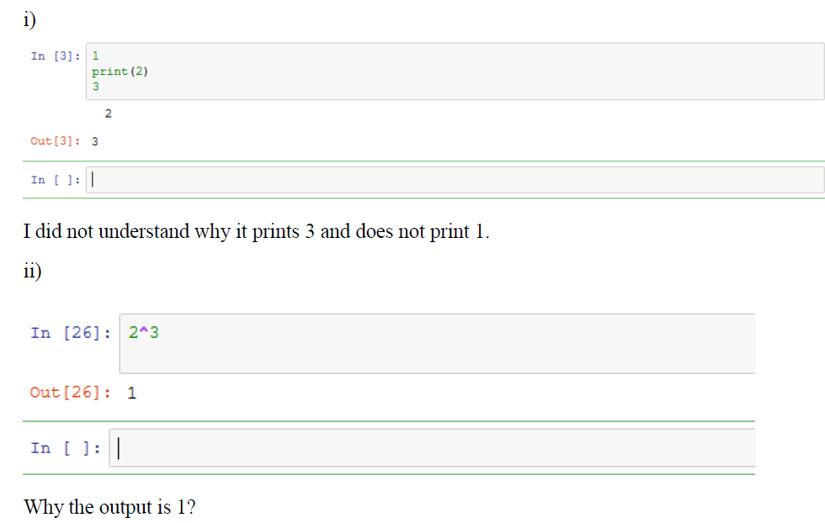
Questions

Slide 5
Let’s get today’s lesson…

Slide 6
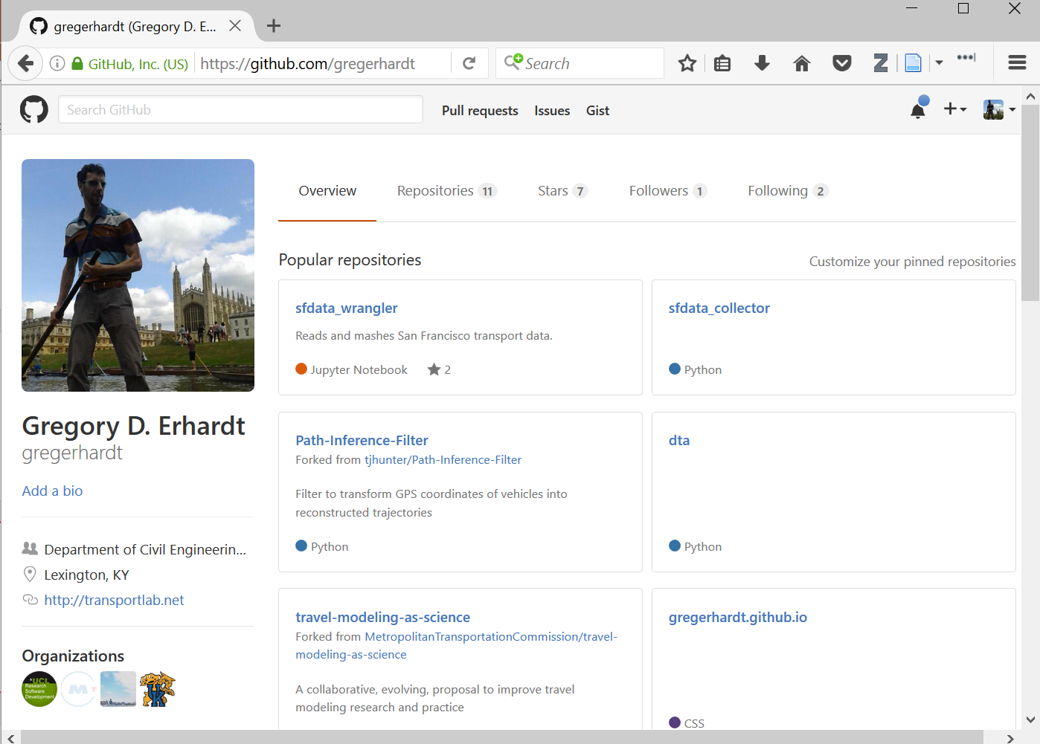
1. Go to github.com and log in.
2. Go to your account.
3. Accept my invitation.
4. Click on our organization.

Slide 7
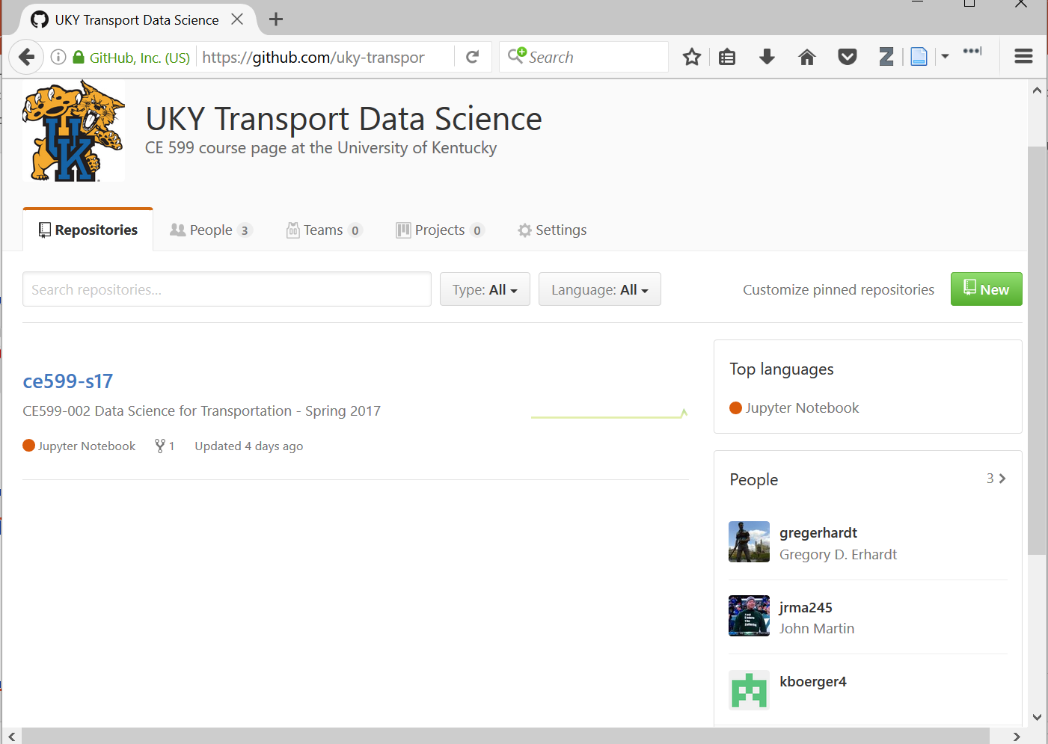
Let’s look at our class repository.

Slide 8
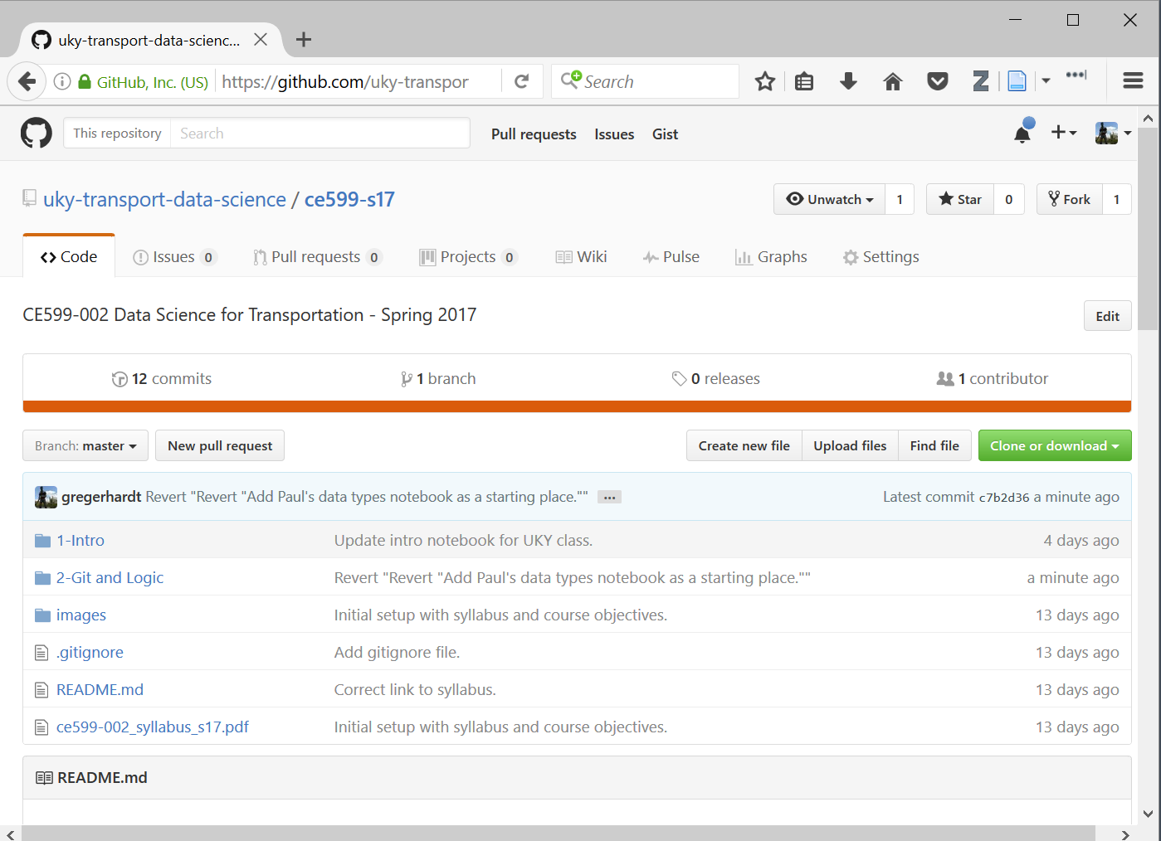
Remember, a repository is just a bunch of files.
Notice that lesson 2 is not posted.
Last time, we just downloaded them to our desktop. We’re going to do it differently this time.

Slide 9
The idea:
I am going to keep posting updates here.
I want you do get those updates.
I also want you to be able to make changes on your own, try new things, experiment, and save your work.
But I don’t want you messing up my nice MASTER version!!!
Version control lets us do that.
Git is version control software.
Github is a HOST that uses git.

Slide 10
Do this by creating a fork.

Slide 11
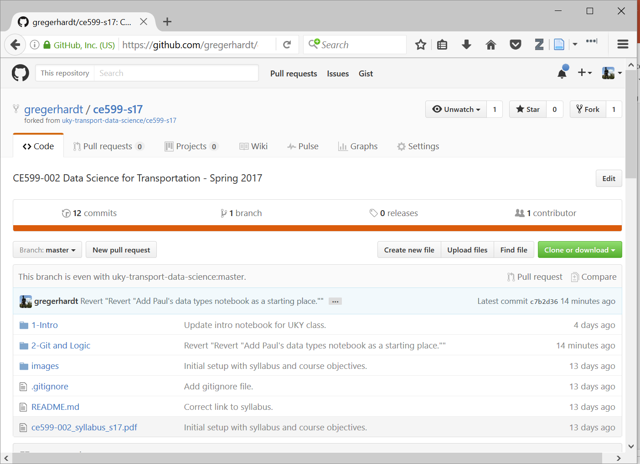
Now you have your own version under your account instead of our class organization.

Slide 12
The idea:
Now you have your own version that you are welcome to mess up!
But it is just sitting on a REMOTE website. You actually wan to work with it on your LOCAL machine.
We will use git to SYNC between the remote and the local version.
(Actually, we will use Github Desktop which puts a nice shiny GUI around git so we don’t have to remember all the command line arguments.)

Slide 13
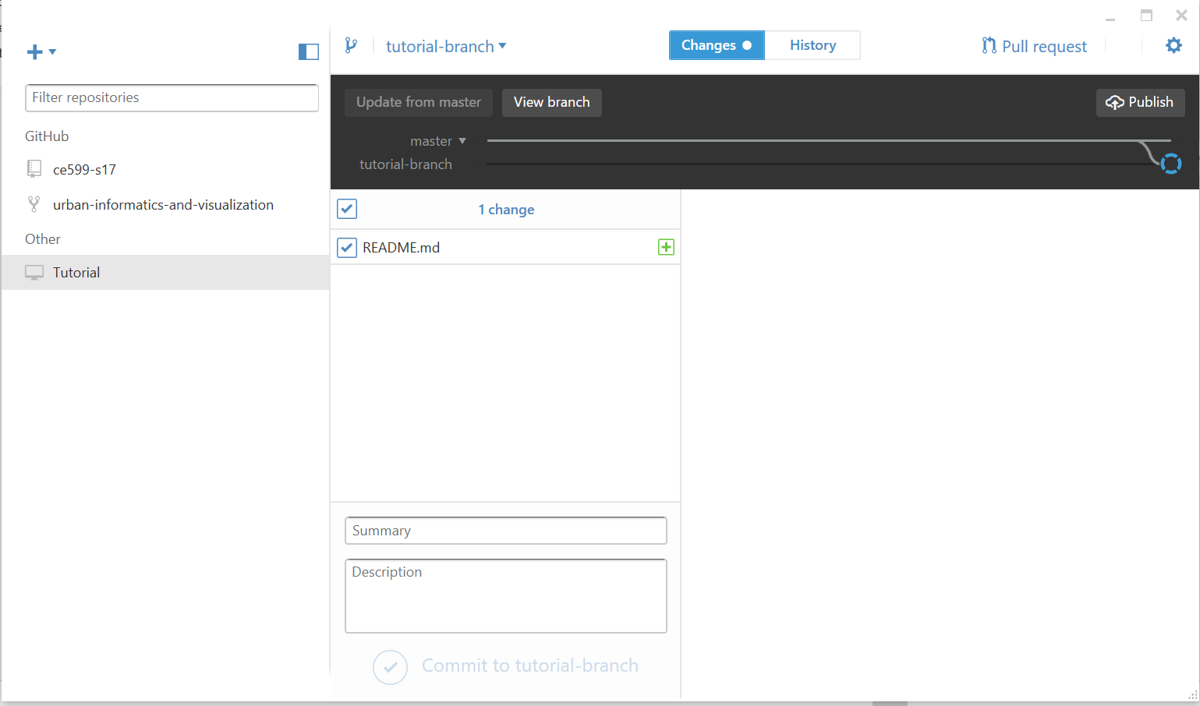
1. Open Github Desktop.
2. Clone your repository.

Slide 14
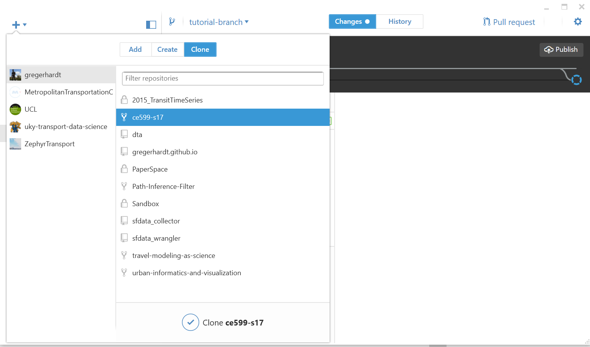
Clone your repository

Slide 15
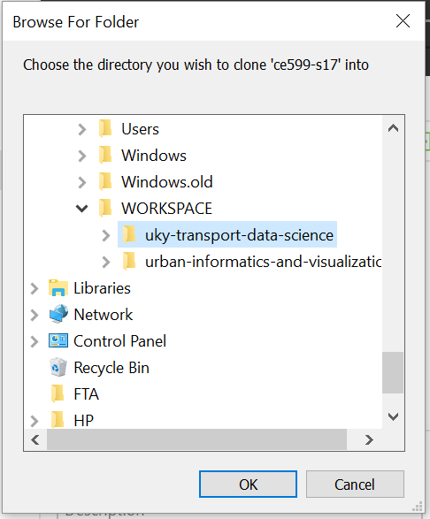
Store it somewhere logical.
I like to keep my repositories in C:\WORKSPACE\

Slide 16
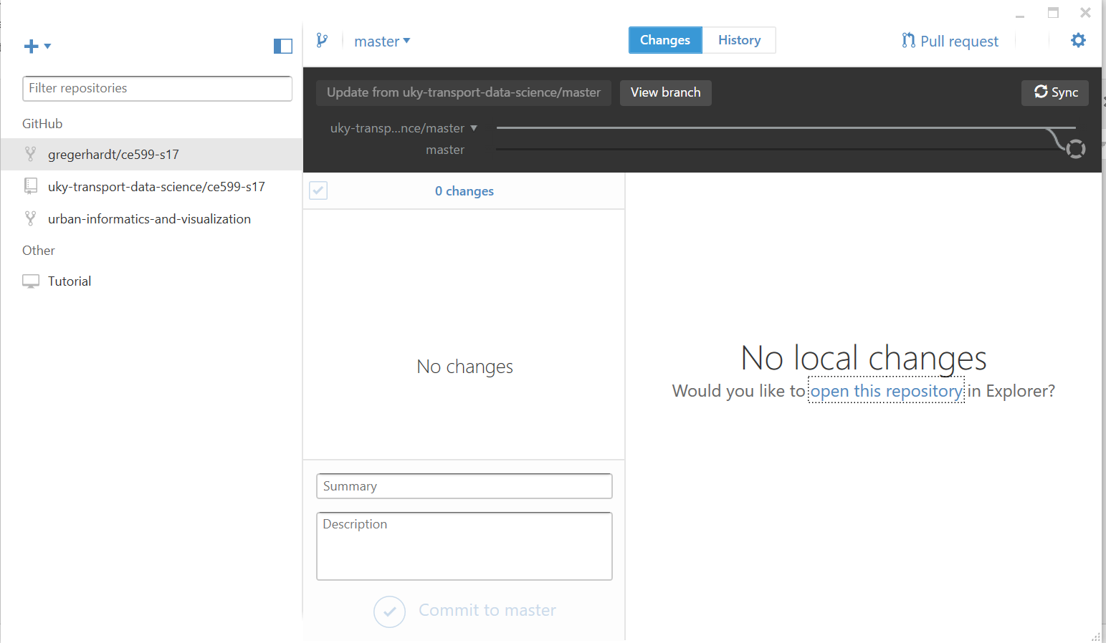
A few things to notice…

Slide 17
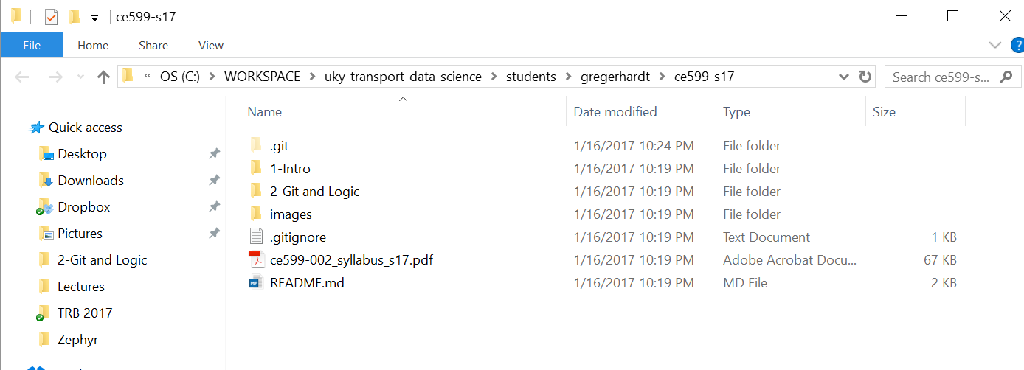
A few things to notice…
Now try changing something. Just add a text file and write a nice poem.

Slide 18
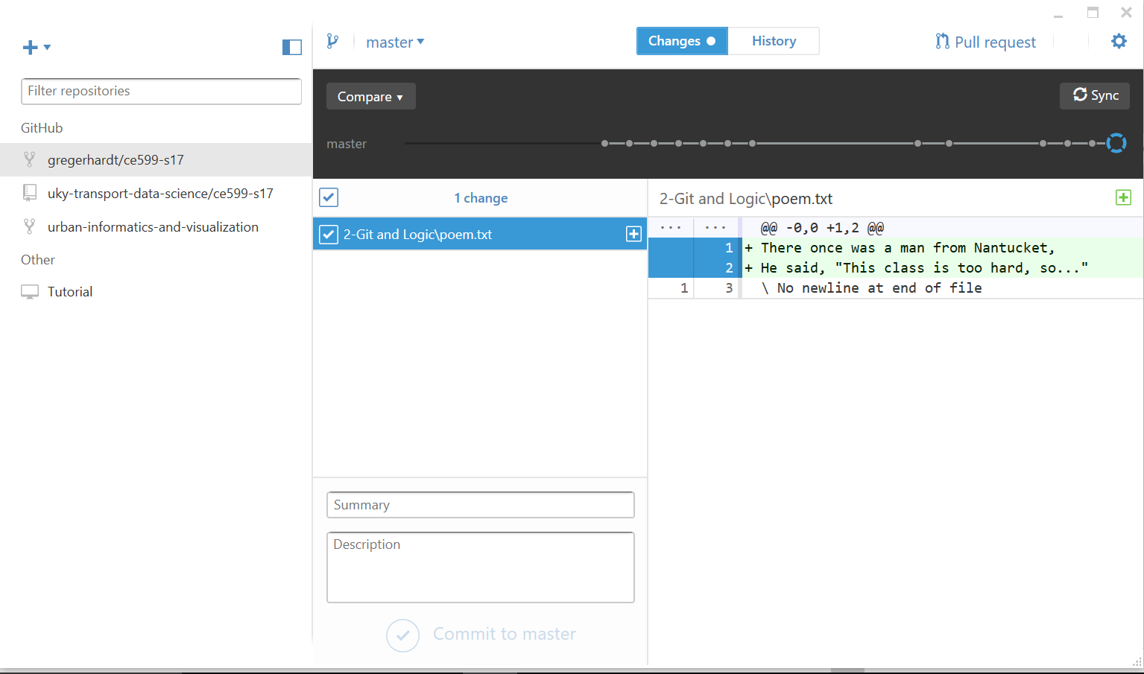
Go back to Github Desktop
Now, COMMIT the change to the repository.
Let’s look at the history.

Slide 19
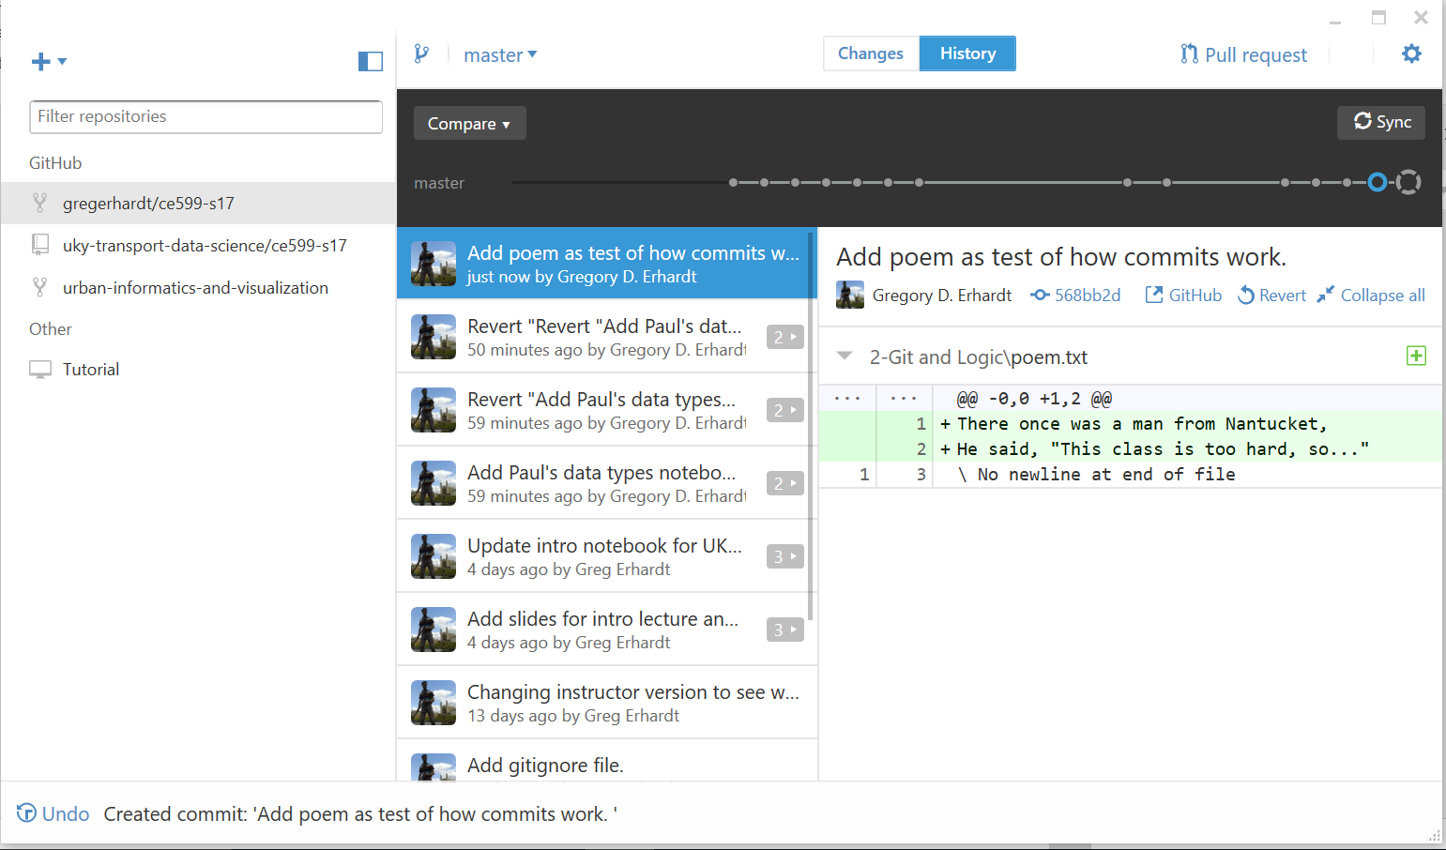
History stores a snapshot of every commit.
This means there is an “UNDO” button!
Now, let’s SYNC with the REMOTE repository.

Slide 20
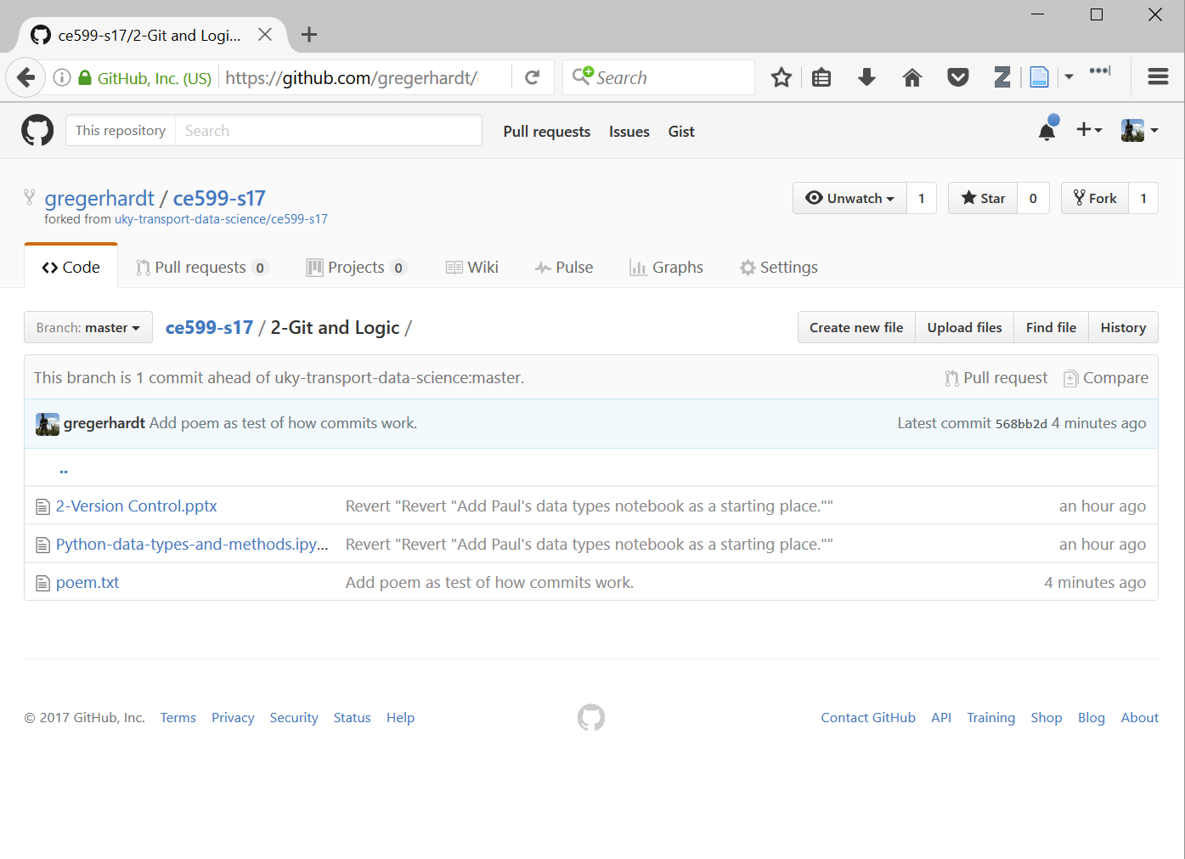
Notice that our current version is saved here.

Slide 21
The idea:
This is how you will submit your work in this class.
Next time, we’ll see what happens when I make changes to the MASTER version.
Version control makes collaboration and sharing practical in programming.
This is a big deal, because you don’t want to do everything yourself, from scratch!

